Slide 1

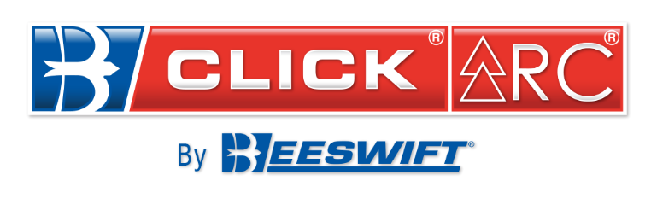
ARC Presentation

Slide 2
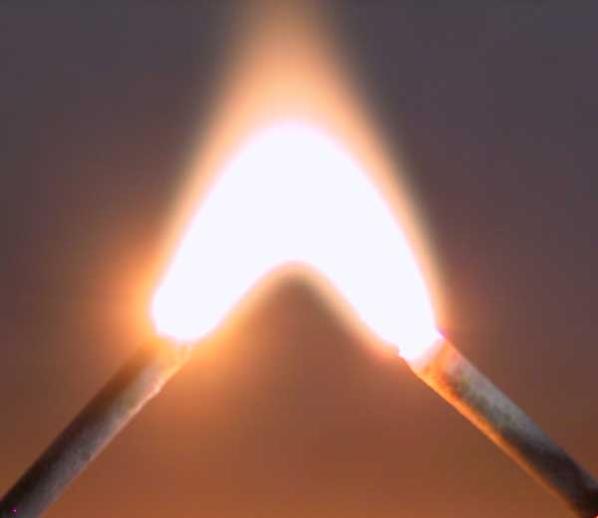

What does ARC mean?
arc
noun
A luminous electrical discharge between two electrodes or other points.
What is an ARC flash?
An arc flash (also called a flashover), is the light and
heat produced as part of an arc fault, a type of electrical
explosion or discharge that results from a low-impedance
connection through air to ground or another voltage
phase in an electrical system.
An electric arc between two nails.

Slide 3
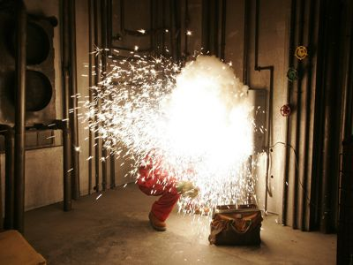
What do the acronyms mean?
kA
Kilo Amps – One thousand amperes.
IEC
International Electrotechnical Commission - non-profit, non-governmental international standards organization that prepares and publishes International Standards for all electrical, electronic and related technologies.
ATPV
Arc Thermal Protective Value - refers to the maximum incident energy (in calories per centimetre squared) that protective equipment can be exposed to and prevent to onset of a second-degree burn. Ratings are based upon the total weight of the fabric.
EBT
Energy Breakopen Threshold - The incident energy on a material
that results in a 50% probability of breakopen. Breakopen is defined
as any open area at least 1.6 cm² (0.5 in.²).
HRC
Hazard Risk Categories -
PPE 1 – 4-8 cal/cm²
PPE 2 – 8-25 cal/cm²
PPE 3 – 25-40 cal/cm²
PPE 4 – >40 cal/cm²

Slide 4
What is article 11B?
Category III PPE must undergo annual checking by a Notified Body, in accordance with Article 11 of the PPE Directive. Manufacturers have two options, 11A or 11B. The Article 11B procedure is suitable for manufacturers of Category III PPE with an approved quality-control system, such as ISO 9000 or similar systems.
What is article 11A?
This involves the Notified Body obtaining a random sample of recently manufactured items of PPE which are then tested by methods used in the original EC type-examination to ensure continuing compliance.
What is EN 61482-1-1, ‘Open Arc’?
'Open Arc' test method (ATPV test and garment test). This replaces IEC 61482-1:2002. The 'Open Arc' test method is the same as the original North American method for measuring the Arc Thermal Performance Value (ATPV), as used in ASTM F1959. Materials or assemblies are given an ATPV value, expressed in kilojoules per square metre (kJ/m2), which can be converted into the familiar cal/cm².
What is EN 61482-1-2, ‘Box Arc’?
The “box arc” test method is based on the European method described in ENV 50354, with a heat transfer measurement. Materials are classified as Class 1 (4kA) or Class 2 (7kA). During this test, a fabric sample is exposed to an electric Arc produced by a 4kA or 7kA short circuit. In the test, the Arc does not last any longer than 500ms. The amount of heat transmitted through the sample is measured during and after the test.

Slide 5
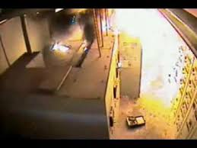
What is a Calorie?
A calorie is the energy required to raise one gram of water one degree Celsius at one atmosphere. The onset of second-degree burns may occur from 1.2 calories/cm². One calorie/cm² can be equal to holding your finger over the tip of a flame of a cigarette lighter for one second.
Why wear ARC protection?
PPE provides protection after an arc flash incident has occurred and should be viewed as the last line of protection. Reducing the frequency and severity of incidents should be the first option and this can be achieved through a complete arc flash hazard assessment and through the application of technology such as high-resistance grounding which has been proven to reduce the frequency and severity of incidents. However use of PPE can be the difference between a workers life or death.
Who wears ARC protection?
Utility Workers
Power generation Workers
Industrial Electrical Workers
Rail Workers
Anywhere there is a chance of an electric current creating an ARC

Slide 6
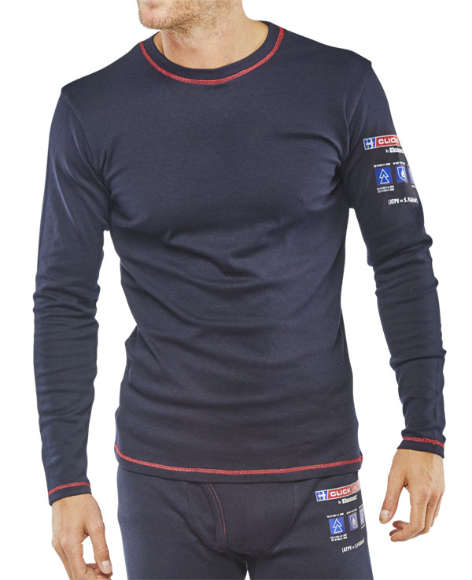
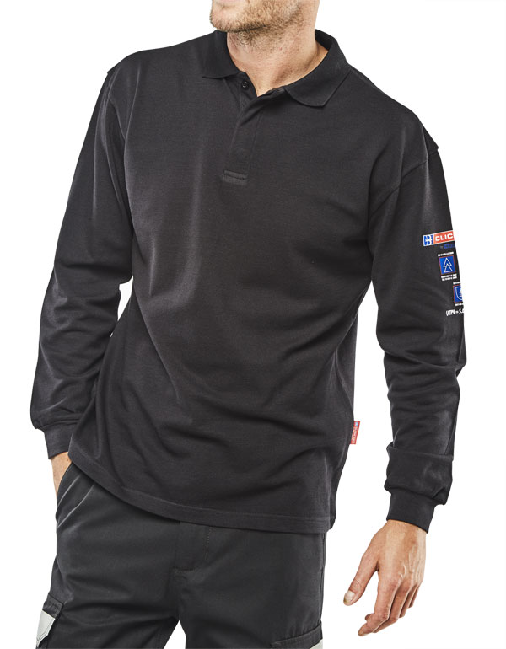
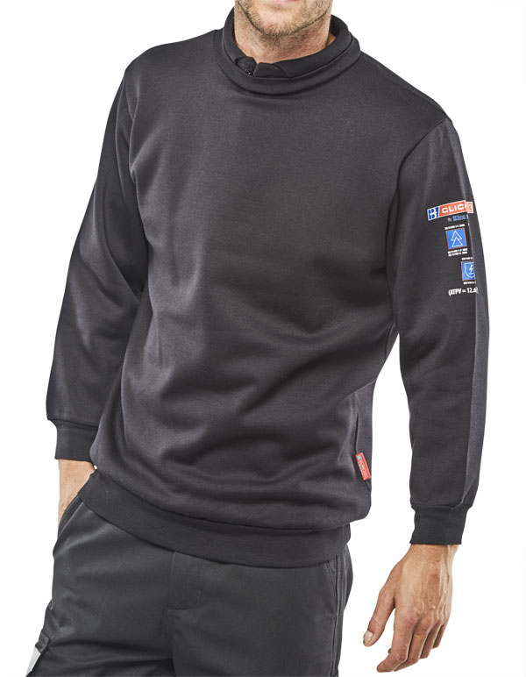
Layering?
When you begin to start layering up ARC garments on top of each other the protection Factor of the
garments also increases.
+
+
+
The insulating layers of air between each layer of ARC material.
CARC22 (5.9cal/cm²)
CARC1 (5.0cal/cm²)
CARC3 (12.6cal/cm²)
=
Combined total cal/cm² rating

Slide 7
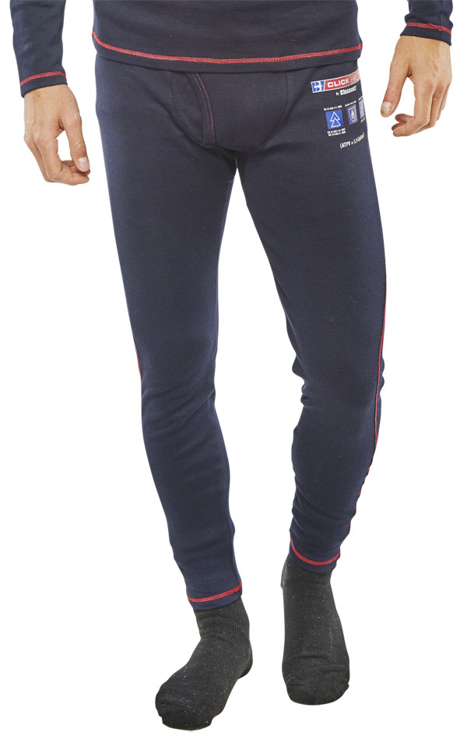
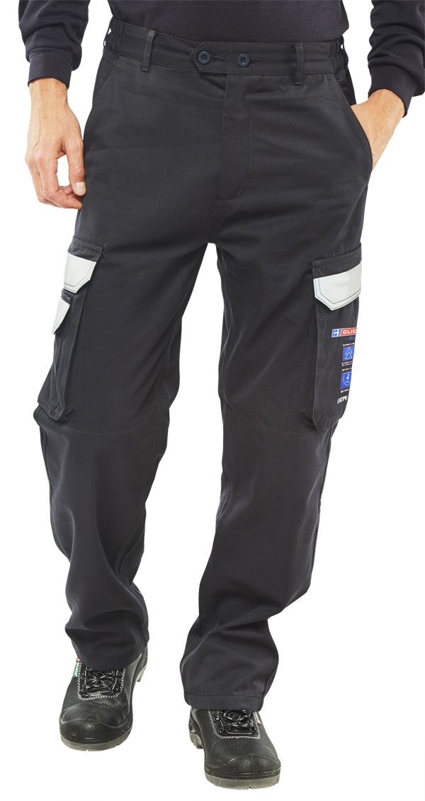
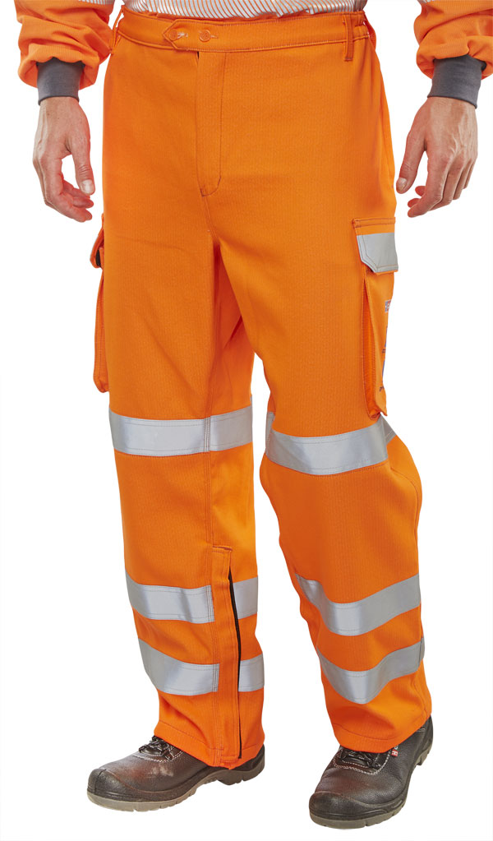
Layering
CARC22
CARC1
CARC22
CARC3
+
=
+
=
16.6cal
36.2cal
5.9cal
5.0cal
5.9cal
12.6cal
CARC24
CARC4
CARC24
CARC52
+
=
+
=
25.1cal
43.6cal
5.9cal
10.8cal
5.9cal
16cal

Slide 8
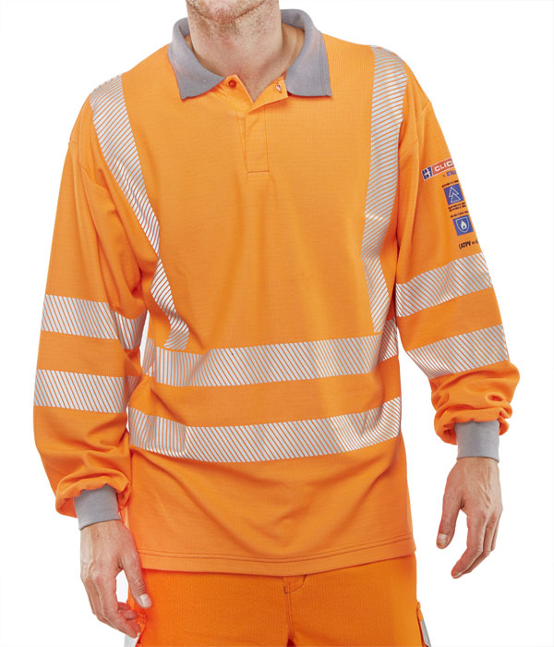
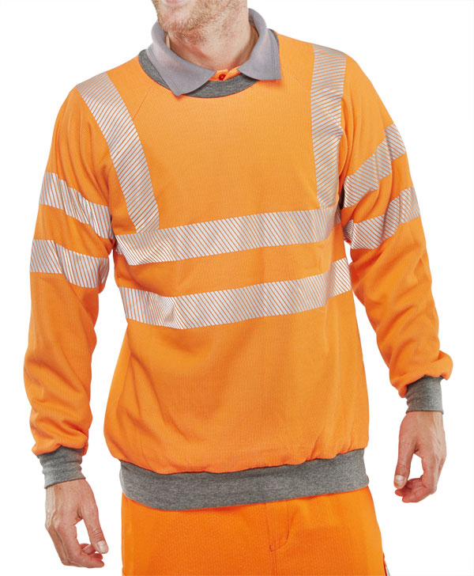
Layering
CARC22
CARC51
CARC22
CARC56
+
=
+
=
18.2cal
22.1cal
5.9cal
6.2cal
5.9cal
12.8cal
CARC22
CARC1
CARC3
+
+
=
44.1cal
5.9cal
5.0cal
12.6cal

Slide 9
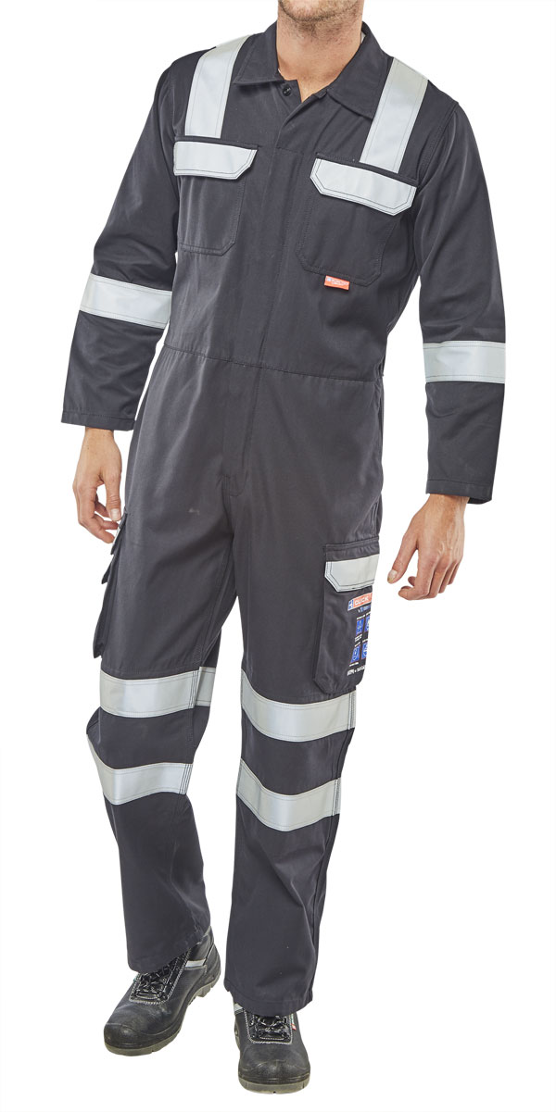
Layering
CARC22
CARC24
CARC1
CARC6
+
+
+
=
37.4cal
5.9cal
5.9cal
5.0cal
10.8cal
CARC22
CARC24
CARC3
CARC6
+
+
+
=
52.5cal
5.9cal
5.9cal
12.6cal
10.8cal

Slide 10
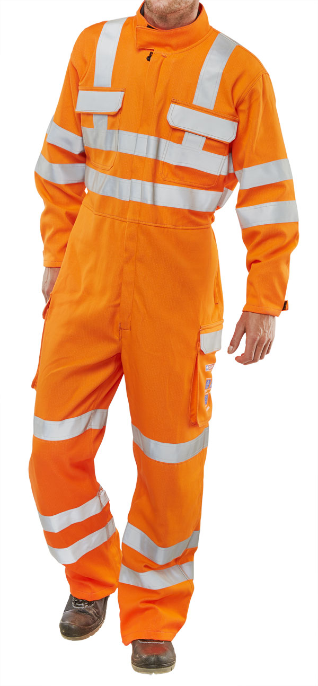
CARC22
CARC24
CARC51
CARC53
+
+
+
=
???cal
5.9cal
5.9cal
6.2cal
16cal
CARC22
CARC24
CARC56
CARC53
+
+
+
=
???cal
5.9cal
5.9cal
12.8cal
16cal

Slide 11
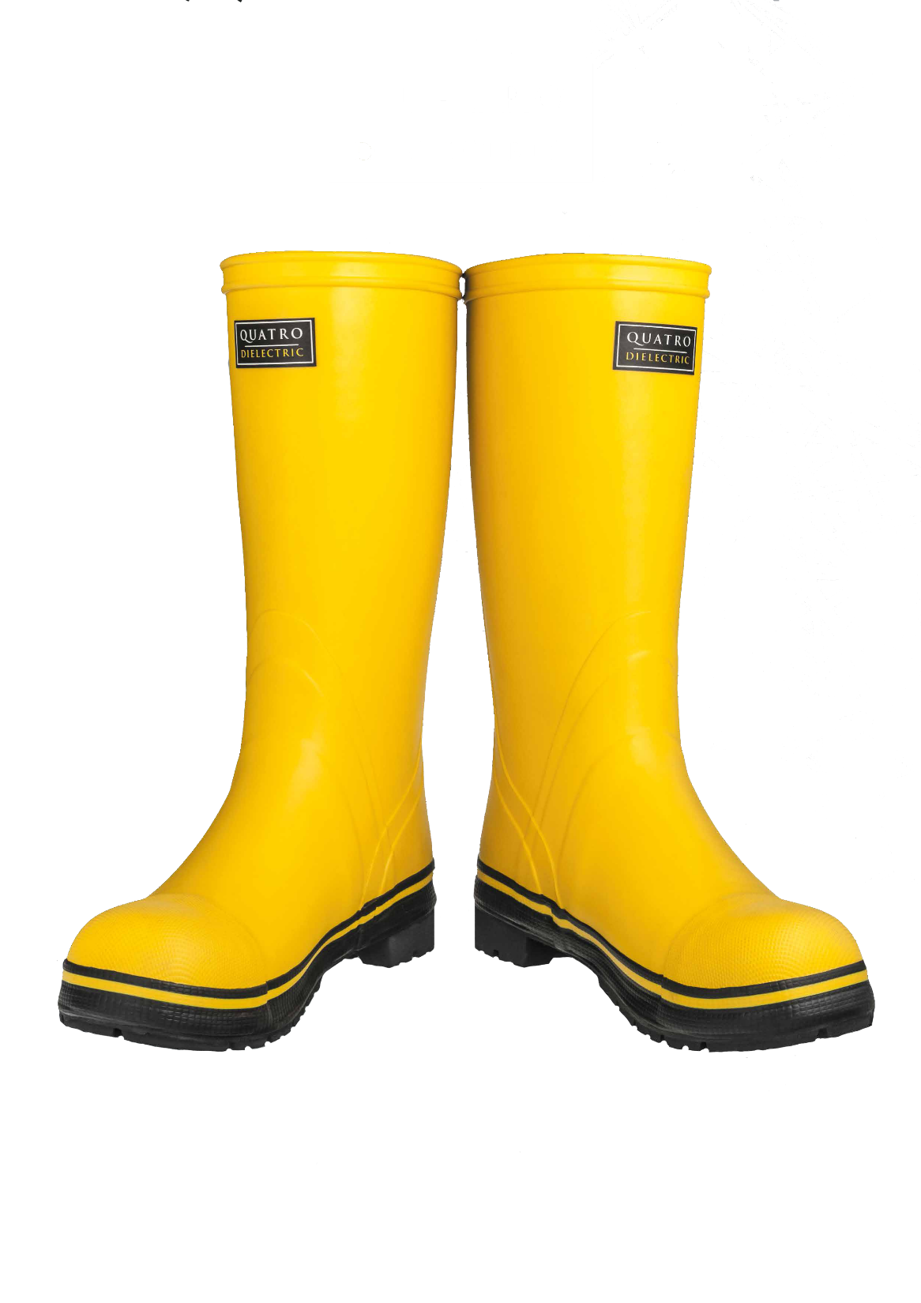
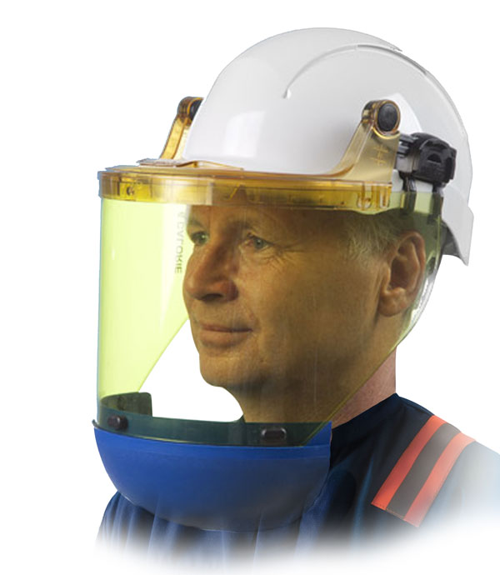
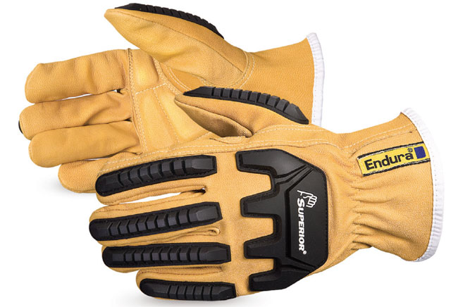
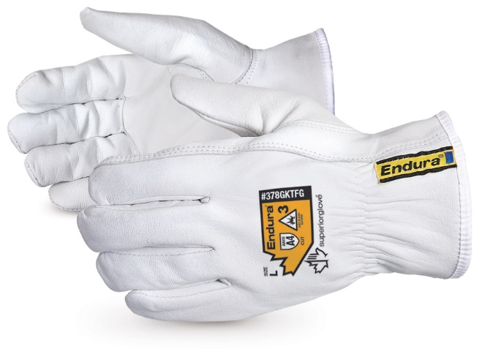
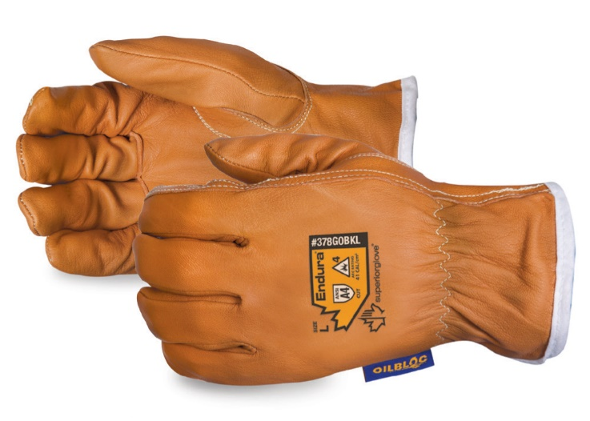
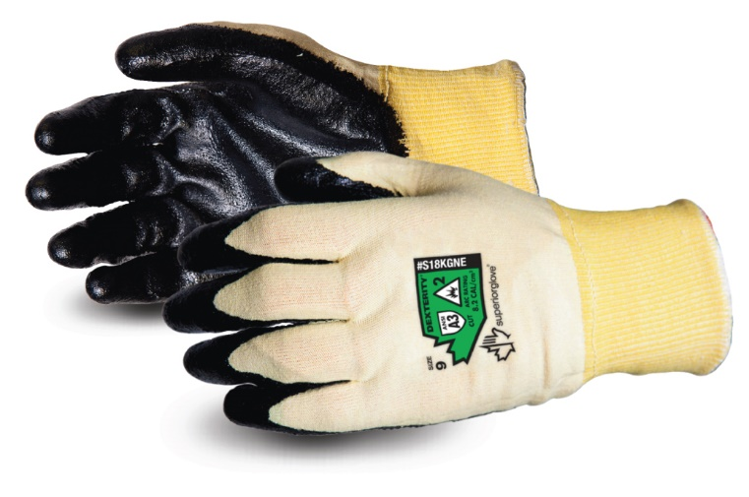
Associated Items
SK202211
CNS25WCC6AEA
SU378GKGVB
SU378GKTFG
SU378GOBKL
SUS18KGNE

Slide 12
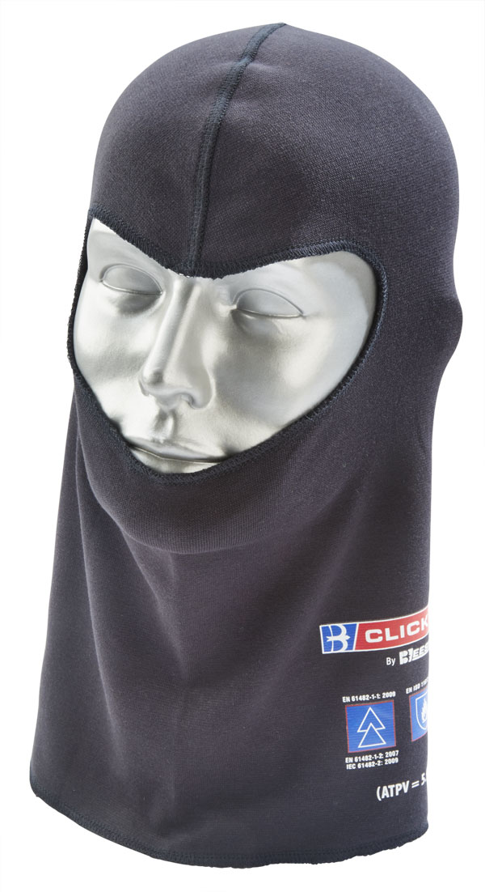
Thermals
CARC22
CARC24
CARC28

Slide 13
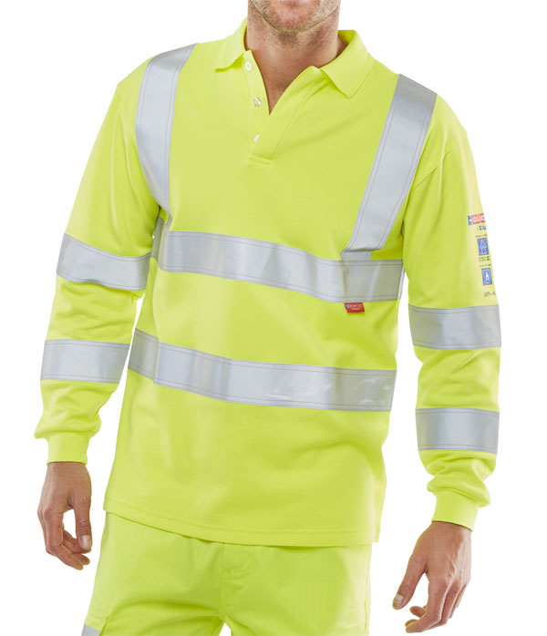
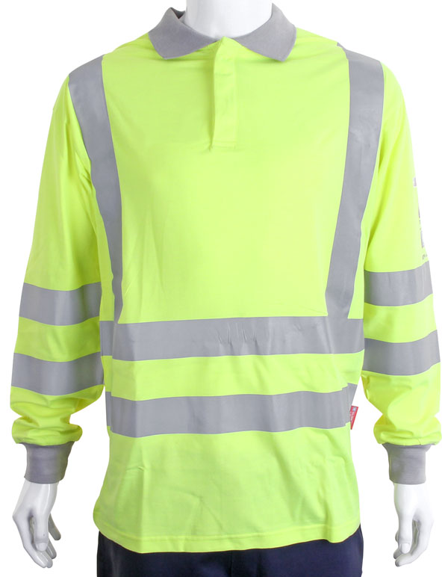
Polo Shirts
CARC1
CARC2
CARC12
CARC51

Slide 14
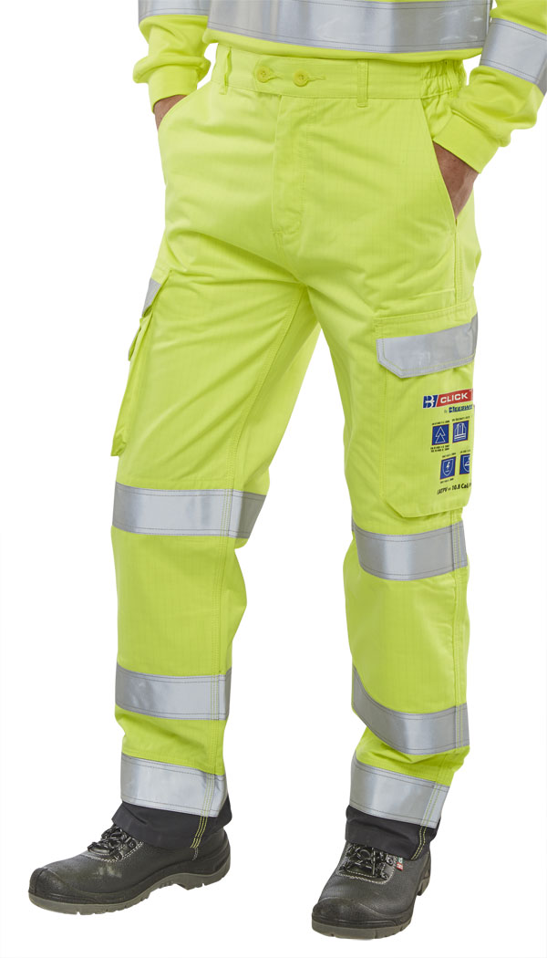
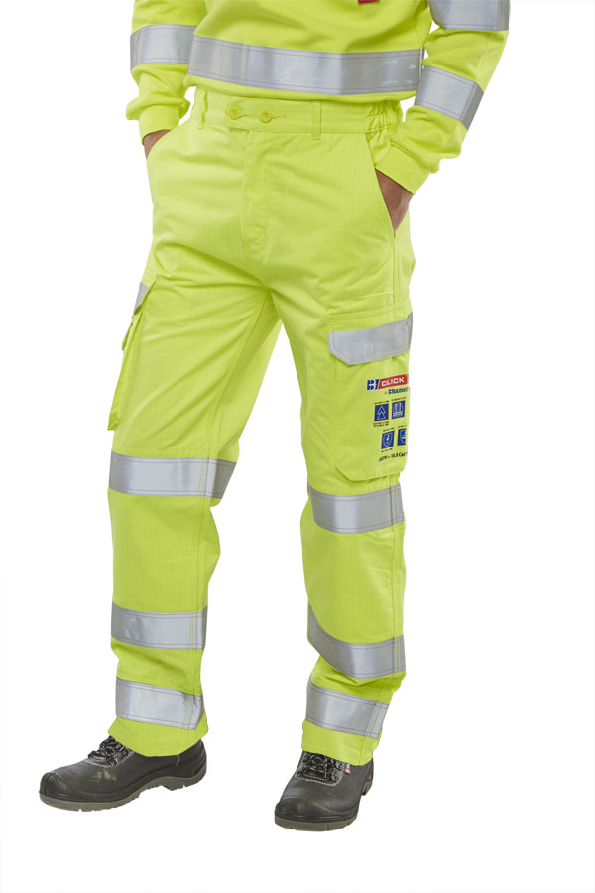
Trousers
CARC4
CARC5
CARC5SY
CARC52

Slide 15
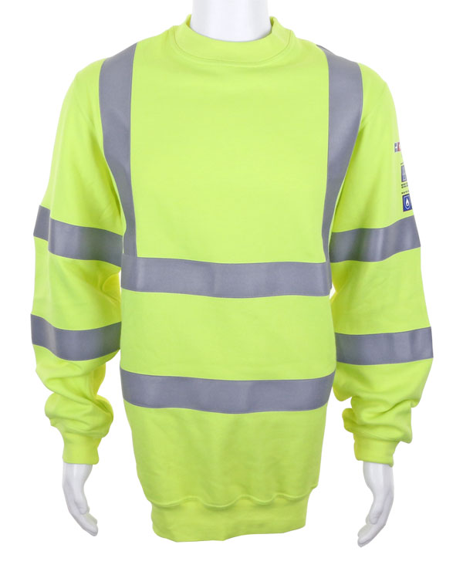
Sweat Shirts
CARC3
CARC8SY
CARC56

Slide 16
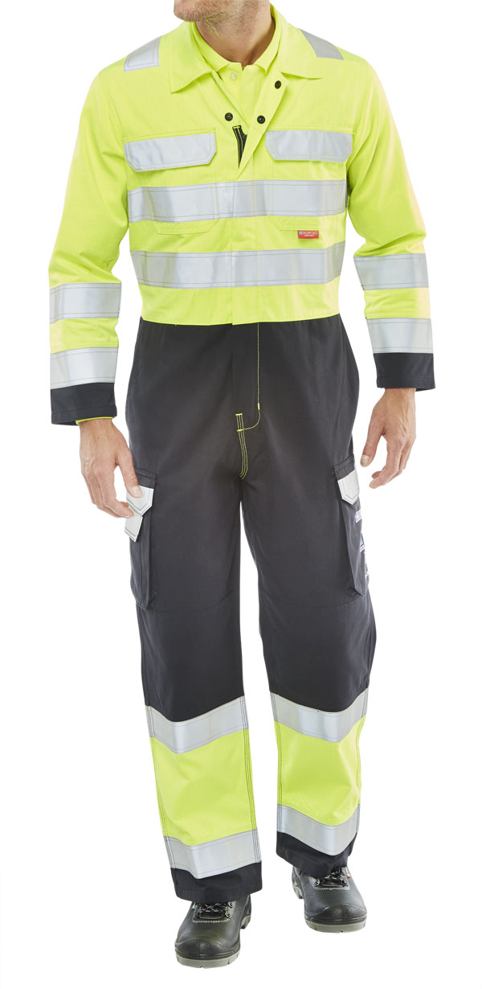
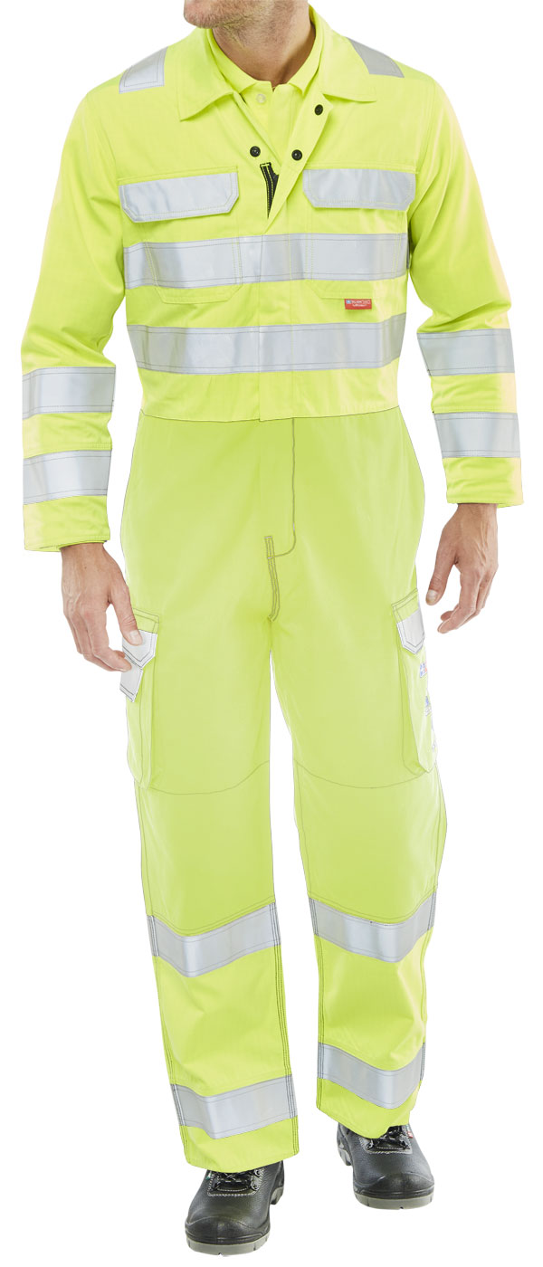
Coveralls
CARC6
CARC7
CARC7SY
CARC53

Slide 17
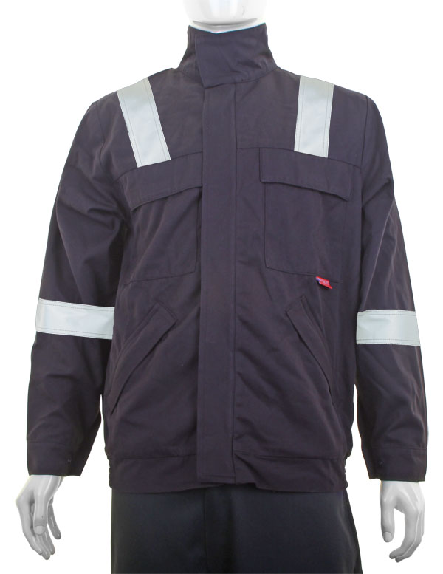
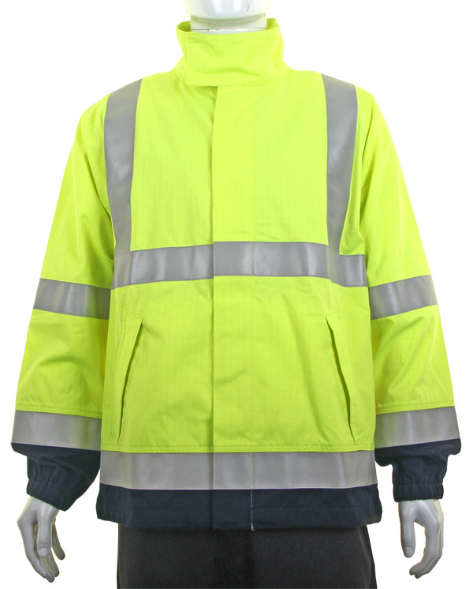
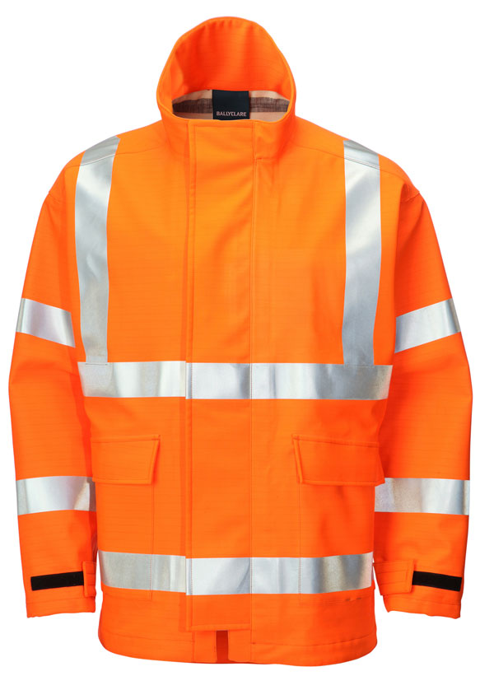
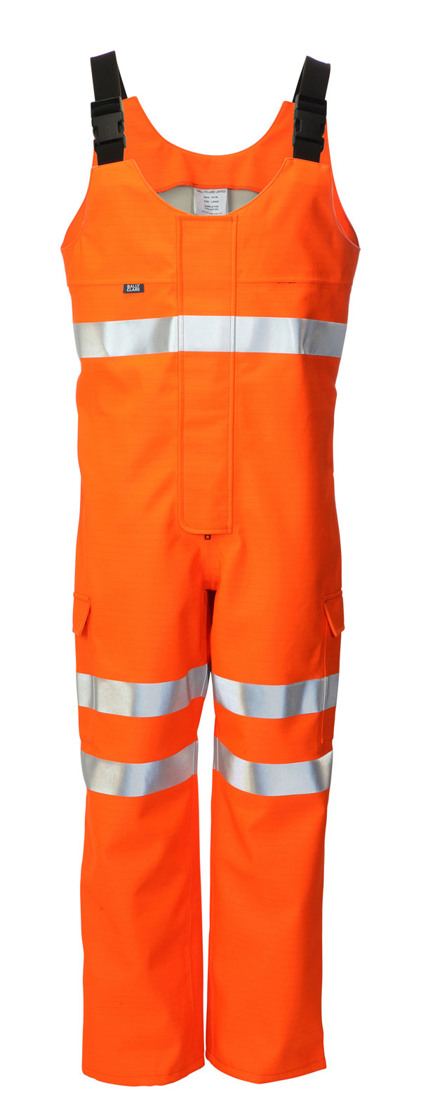
Jackets
CARC920
CARC925
HV1344
HV1964
Coming Soon
Click ARC Fleece
Click Arc Soft Shell
Click Arc Class 2 (7kA) Jackets, Trousers & Coveralls

Slide 18
For further information please visit www.Beeswift.co.uk
Or contact a sales representative at sales@Beeswift.com
This presentation’s intellectual property and design where applicable belongs to:
BEESWIFT Ltd, Delta Point, Greets Green Road, West Bromwich, B70 9PL. UK.

