Slide 1

EN ISO 20471
High Visibility Clothing

Slide 2
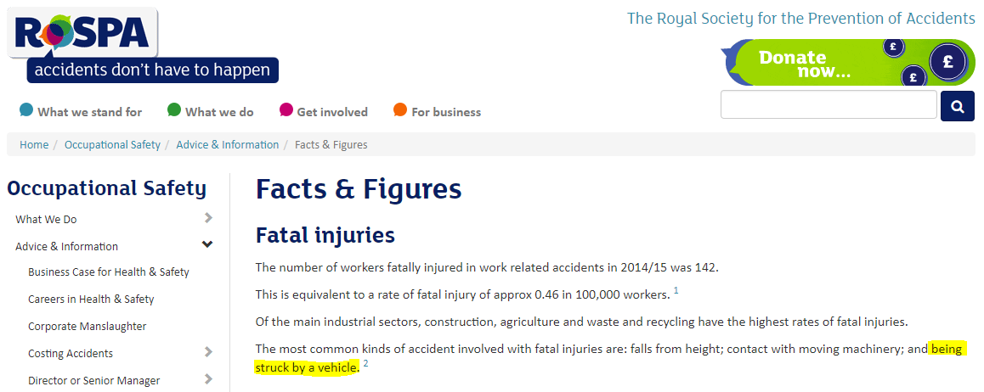

One of the most common protective standards around today is EN ISO 20471. It is the standard which deals with all industrial high visibility clothing.
*Taken from the RoSPA website 09/01/2018
Being struck by a vehicle is one of the most common accidents that causes fatalities, this could be negated through correct use of conforming PPE.

Slide 3
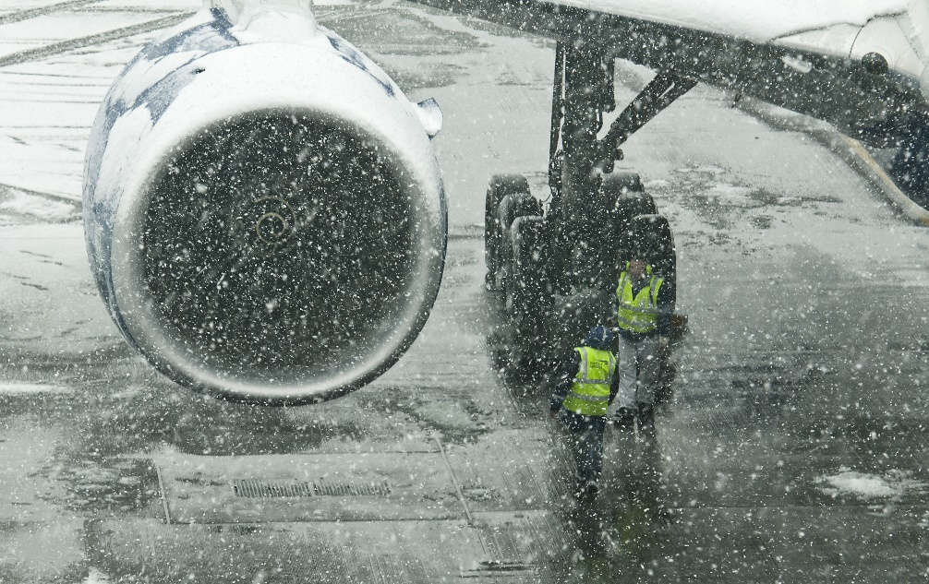
This is the difference between wearing and not wearing High Visibility in the day when human eyesight is strongest. In a night time situation this would only get worse as human eyesight isn’t suited to night vision.

Slide 4
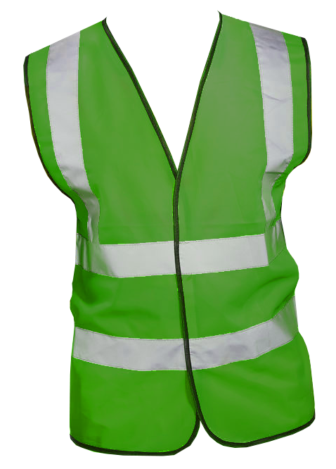
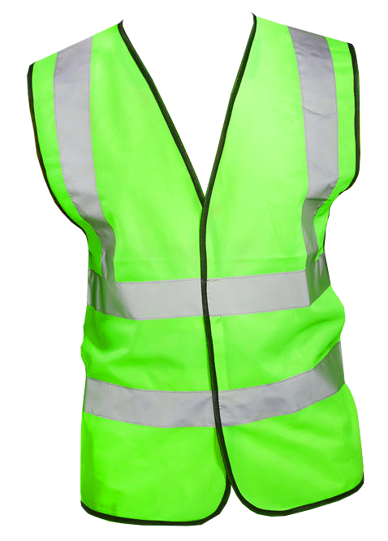
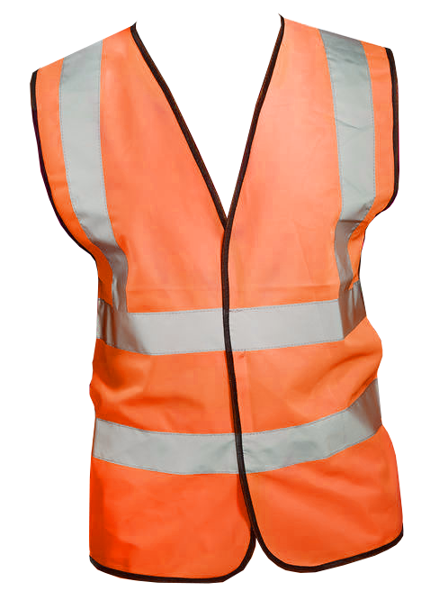
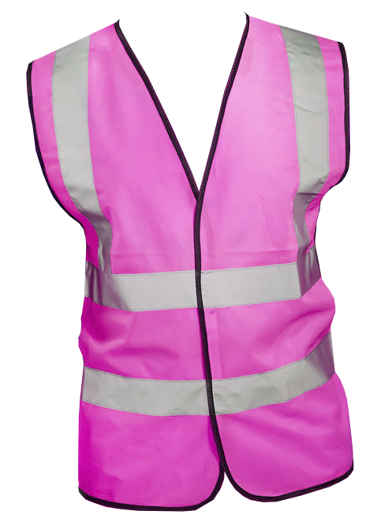


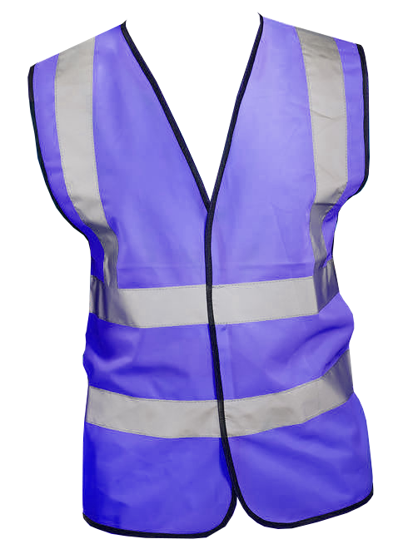
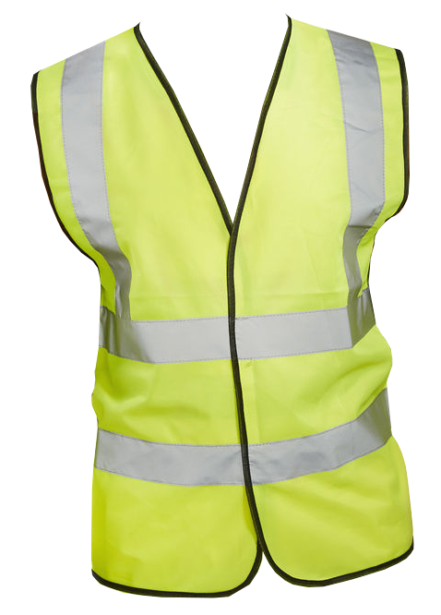
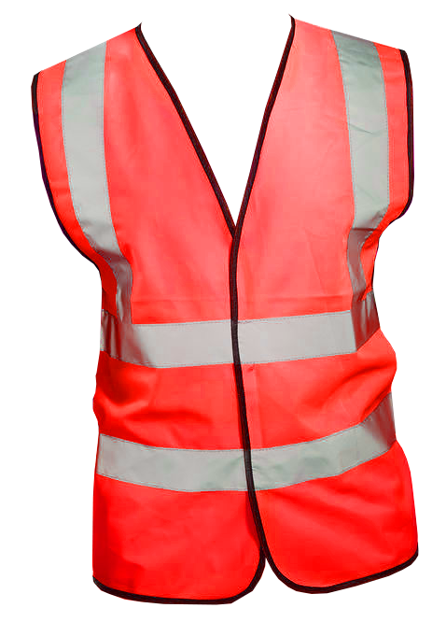
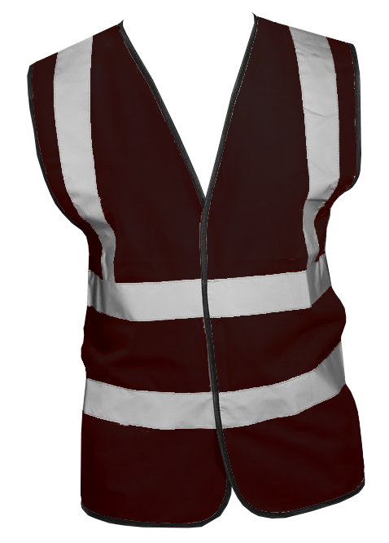
What is High Visibility?

Slide 5

For a garment to pass as high visibility there MUST be the correct amount of retro-reflective tape alongside the correct amount of high visibility background fabric.
Just because a garment may use the background fabric without tape does not make the garment high visibility, and neither does a garment using the correct tape but incorrect background fabric make it high visibility.
The only 3 colours of background fabric are:
Hi-Visibility Red
Saturn Yellow
Hi-Visibility Orange

Slide 6
A garment using one of the 3 colours (they must still pass a colour test) that also uses the correct tape must do so with certain amounts of both fabric and retro reflective tape to achieve a classification level 1-3. The amounts are:
Classification level |  | Minimum background fabric | Minimum Retro-reflective tape | Min thickness of tape
Class 3 | Highest protection | 0.80m² | 0.20m² | 50mm
Class 2 | Intermediate protection | 0.50m² | 0.13m² | 50mm
Class 1 | Lowest Protection | 0.14m² | 0.10m² | 50mm

Slide 7
One of the most important rules with high visibility is DO NOT ALTER THE GARMENT.
Once a garment is altered, such as, shortening sleeves/legs, cutting away tape, it may no longer conform to the classification it was given or it may not even conform to the EN ISO 20471 standard anymore.
Make sure that garments are washed regularly and to the correct washing instructions otherwise it may longer conform to the standard. If a garment is permanently soiled then dispose of it in a safe and responsible manner.
The pictogram for high visibility is:
The number denotes the classification of high visibility.

Slide 8
RIS-3279-TOM Issue 1
(Formerly GO/RT 3279 Issue 8)
RIS – Rail Industry Standard
TOM – Traffic Operations and Management standards committee

Slide 9
GO/RT 3279 High Visibility Clothing, issue eight, duplicated common European requirements for ‘providing staff with relevant safety equipment’, in particular those set out in:
a) Common Safety Method for assessing conformity with the requirements for obtaining a railway safety authorisation (EU 1169/2010).
b) Common Safety Method for assessing conformity with the requirements for obtaining railway safety certificates (EU 1158/2010).
It is therefore formally ‘redundant’ as a National Safety Rule, and therefore also as a Railway Group Standard. As a consequence, it has been withdrawn.

Slide 10
However, the content of GO/RT 3279 provides a basis for the infrastructure manager (IM) and railway undertakings (RUs) to provide staff with relevant safety equipment.
It also sets out the industry’s agreed allocation on the minimum technical criteria of high visibility clothing for use by staff on the GB mainline railway (the GB mainline railway refers to the UK mainline railway system, but excluding Northern Ireland, High Speed 1 and the Channel Tunnel).
GO/RT 3279 has therefore been replaced by this Rail Industry Standard (RIS-3279-TOM) High Visibility Clothing, which reproduces the content of GO/RT 3279 in its entirety.
The time to use garments to this standard is when doing work on the lineside or on or near the line. (Within 3 metres of the nearest rail of any line, and on the line itself.)
On a platform, the term “on or near the line” applies only to the part of the platform within 1.25 metres of the platform edge and only when an engineering or technical activity is taking place.

Slide 11
For further information please visit www.Beeswift.co.uk
Or contact a sales representative at sales@Beeswift.com
This presentation’s intellectual property and design where applicable belongs to:
BEESWIFT Ltd, Delta Point, Greets Green Road, West Bromwich, B70 9PL. UK.

