Slide 1
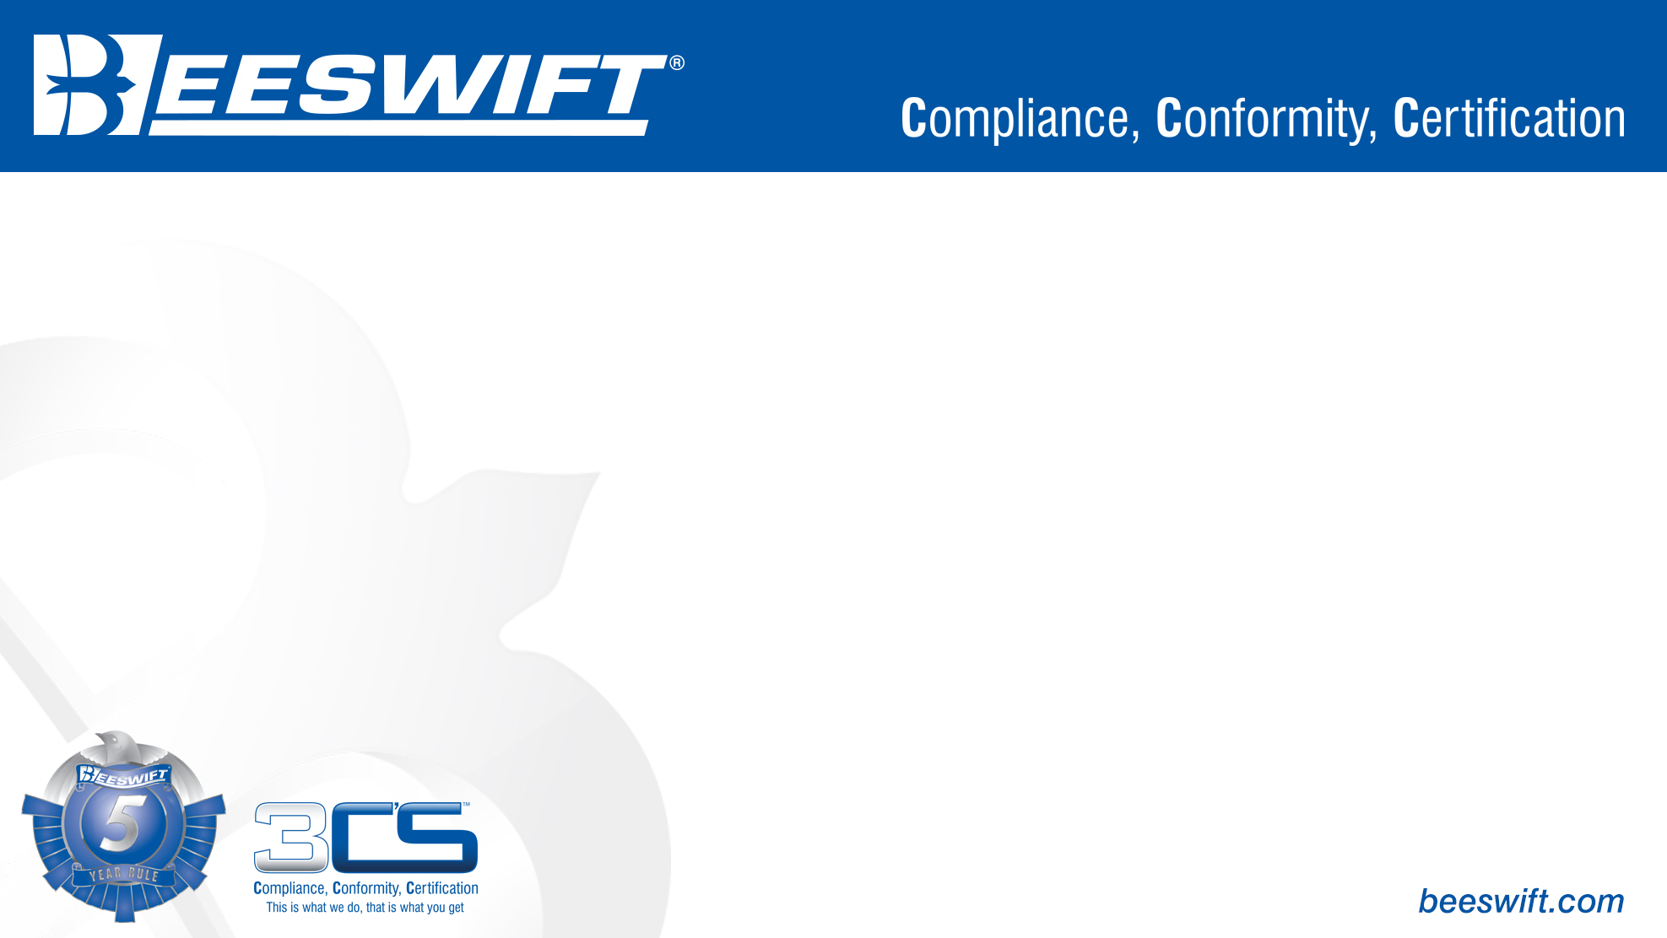
Protection against rain – EN 343
Freezerwear – EN 342

Slide 2
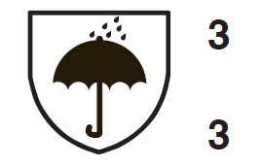

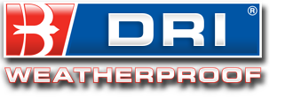
EN 343– Protection against rain
Protective clothing is certified to the EN343 standard to withstand precipitation, fog and ground humidity and is tested accordingly. It also accounts for the breathability of the garment in such conditions.
On the label the EN 343 pictogram will be followed by two numbers. For example,
The top digit denotes its water penetration resistance, whilst the bottom digit denotes its breathability.

Slide 3
EN 343– Protection against rain
EN343 Resistance to Water Penetration is split into 3 levels:
Class 3 affords the highest level of foul weather protection
Class 2 provides an intermediate foul weather protection
Class 1 provides the entry level of foul weather protection
EN343 Breathability is also split into 3 levels:
Class 3 affords the highest level of breathability
Class 2 provides an intermediate level of breathability
Class 1 is not classified as breathable under the standard
Please note EN343 certified garments will protect the wearer against these conditions provided that:
The garment is fully closed before use to ensure maximum protection.
The fabric is clean. (If it is dirty its performance may be impaired)
The protective clothing is stored in a dry and well-ventilated space.
The garment is cared for according to the washing instructions to ensure maximum protective performance.

Slide 4

EN 342– Ensembles and garments for protection against cold.
This standard specifies requirements and test methods for performance of clothing ensembles (i.e. two piece suits or coveralls) and of single garments for protection against cold environments. Cold environments are characterised by the combination of humidity and wind at air temperature below -5°C. The measured properties and their subsequent classification are intended to ensure an adequate protection level under different user conditions. Protective clothing, designed to be worn at sub-zero temperatures, must not only effect a sufficiently high thermal insulation, largely independent of the outer wind speed, but they must also be breathable, enabling a good evaporation of sweat from the body. Without the latter the garment layers next to the body get moist or wet by sweat condensation, losing completely their thermal insulation and leading to hypothermia. According to these demands the standard EN 342 defines 3 criteria to ensure the physiological function of protective clothing against cold:

Slide 5
EN 342– Ensembles and garments for protection against cold.
Thermal insulation (Icle and Icler). Insulation is the most important property and it is measured by using a full-sized thermal manikin with the ensemble or garment and accompanying reference clothing in order to account for the effect of layers, fit, drape, coverage and shape. It should be recognised that ensemble and garments in frequent use may lose significant insulation capacity due to laundering and wear.
Air permeability (AP). Wind may considerably increase convective heat losses. Therefore, the air permeability of the outer garment material is an important factor to be taken into account in relation to the protection of the wearer against cold. In cold climate a low air permeability is advantageous, because in outdoor wind conditions it prevents a penetration of cold air through the garment layers into the microclimate next to the body, reducing the effective thermal insulation of the PPE.
Resistance to water penetration (WP). Testing of resistance to water penetration is optional. If water penetration resistance is required than water vapour resistance Ret shall be measured. The lower the water vapour resistance, the better the breathability of the clothing.

Slide 6
For further information please visit www.Beeswift.co.uk
Or contact a sales representative at sales@Beeswift.com
This presentation’s intellectual property and design where applicable belongs to:
BEESWIFT Ltd, Delta Point, Greets Green Road, West Bromwich, B70 9PL. UK.

