Slide 1
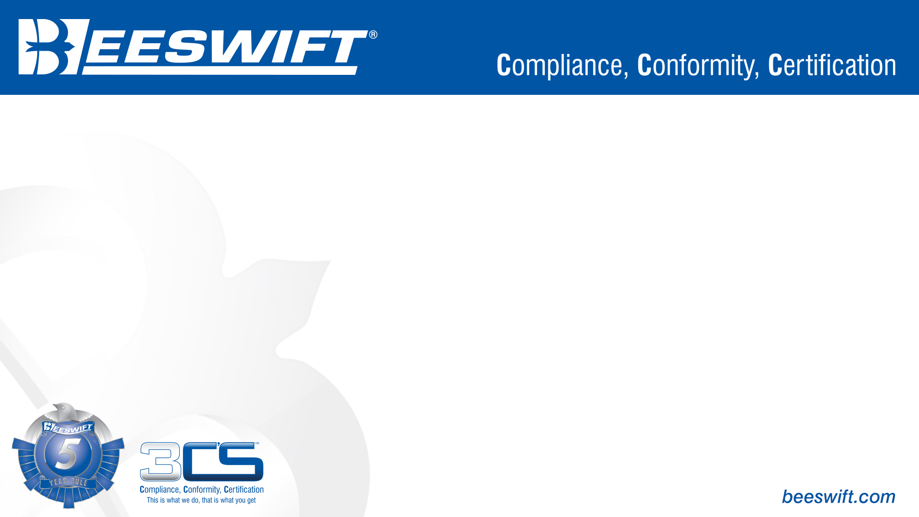
Eyewear – EN 166
Respiratory – EN 149
Ear Defence – EN 352
Bump Caps – EN 812
Helmets – EN 397

Slide 2




EN 166 – Personal eye protection
EN 166 tests both the lenses and the frames of protective eye wear. On every pair of safety spectacles it should have markings on both the lenses and the frames. The tests include:
Filtering
Code Number | Type of Filter
2 | UV Filter
2C or 3 | UV Filter with good colour recognition
4 | Infrared filter
5 | Sun glare filter
6 | Sun glare filter with IR specification
Shade Number | Shade Colour/s
1,2 | Clear / Amber
1,7 | I/O / Minimizer
2,5 | Bronze / Grey
3,1 | Dark Bronze / Dark Grey / Blue Mirror / Red Mirror

Slide 3
EN 166 – Personal eye protection
Optical Class
Optical Class | Wearing Time
1 | Permanent Wear
2 | Intermittent Wear
3 | Sparse Wear
Impact Resistance
Details | Frame Marking | Lens Marking | Test
Increased Robustness |  | S | Resists a 22mm, 43g ball at 12 m/s.
Low Energy Impact | F | F | Resists a 6mm, 0.86g ball at 45 m/s.
Medium Energy Impact | B | B | Resists a 6mm, 0.86g ball at 120 m/s.
High Energy Impact | A | A | Resists a 6mm, 0.86g ball at 190 m/s.
Extreme Temperature | T | T | The letter “T” after the impact rating means it has that impact rating at extreme temperatures (-5 to +55)

Slide 4
EN 166 – Personal eye protection
Additional Requirements
Reference Letter/Number | Protection Against
8 | Short circuit electric arc
9 | Molten metal splash
K | Scratch Resistance
N | Resistance to fogging
Fields of Use
Code Number | Protection Against
3 | Liquid Droplets (Goggles) / Liquid Splashes (Visors)
4 | Large Dust Particles (up to 5µm) (Goggles)
5 | Gas and Fine Dust (below 5µm) (Goggles)
8 | Short Circuit Electric Arc (Visors)
9 | Molten Metal and Hot Solids (Goggles/Visors)

Slide 5
EN 149 – Respiratory protective devices
RPE (Respiratory Protective Equipment) is designed to protect the wearer against inhalation of hazardous substances in the air.
Respirator (filtering device) uses filters to remove contaminants in the workplace air. Respirators should never be used for protection in situations with reduced oxygen levels.
Particle filters have 3 ratings:
P3 – Highest Efficiency (98% Particulates covered)
P2 – Medium Efficiency (92% Particulates covered)
P1 – Lowest Efficiency (80% Particulates covered)
There are three main types of filters:
Particle filters
Gas/Vapour filters
Combined filters (particles/gases)
Masks marked with a “D” have been tested to Dolomite increased dust clogging.

Slide 6
EN 149 – Respiratory protective devices
Gas/Vapour Filters
Filter Type | For use against | Colour code | Other Information
A | Organic gases and vapours, boiling point >65°C | Brown | EN 14387
B | Inorganic gases and vapours | Grey | EN 14387, do not use against carbon monoxide
E | SO2 and other acidic gases | Yellow | EN 14387
K | Ammonia and its organic derivatives | Green | EN 14387
Hg | Mercury | Red & White | EN 14387, includes P3 particle filter, Maximum use time 50 hours, no class number
NO | Oxides of nitrogen | Blue & White | EN 14387, includes P3 particle filter, Single use, no class number
AX | Organic gases and vapours, boiling point <65°C | Brown | EN 14387, Single use, no class number
SX | Substances as specified by the manufacturer | Violet | EN 14387

Slide 7
EN 352 – Hearing protection
EN 352 has multiple sections the basic parts are EN 352-1, EN 352-2 and EN 352-3.
EN 352-1 covers ear-muffs.
EN 352-2 covers earplugs.
EN 352-3 covers ear-muffs attached to industrial helmets.
EN 352 changes to CAT III on 21/04/2018
To understand hearing defence you need to first understand what you are defending from. When you don a piece of hearing protection you are protecting yourself from continuous damaging sound.
Sound intensity is measured in dB (decibels) and when you use hearing protection you dampen that noise level by the SNR of the hearing protection.
SNR (Single Number Rating) values can be used to compare the level of noise attenuation offered by different hearing protectors. To determine acoustic pressure on your ears, you subtract the SNR value from the average noise level measured.
If the noise level measured 100dB.
You are wearing Beeswift’s QED31 with an SNR rating of 31.
The acoustic pressure on your ears is on average 100 – 31 = 69dB
You can also check for a hearing protectors HML ratings. Which are the noise reduction values of the hearing defence at High, Medium and Low frequencies.

Slide 8
EN 352 – Hearing protection
Once a sound hits 80dB protection is required. Above 80dB you can go for certain lengths of time before serious and permanent damage will occur. This however doesn’t mean Hearing protection isn’t required. Above 80dB is the level at which a noise survey needs to be carried out to determine the hearing protection required.
Sound pressure in dB(A) | Safe length of exposure
80dB(A) | 8 hours
83dB(A) | 4 hours
86dB(A) | 2 hours
89dB(A) | 1 hours
92dB(A) | 30 minutes
95dB(A) | 15 minutes
98dB(A) | 7 minutes and 30 seconds
101dB(A) | 3 minutes and 45 seconds
104dB(A) | 2 minutes
107dB(A) | 1 minute

Slide 9
EN 812 – Industrial Bump Caps
Industrial Bump Caps are there to protect your head from static objects that you could “bump” your head into. (E.g. walking into low ceilings or hanging obstructions). Industrial Bump Caps are tested for:
Impact/Shock Absorption
Impact tests are carried out similar to those required for industrial helmets, but using a lower energy level – a 5kg flat striker is dropped onto the helmet from a height of 250mm, with a maximum allowable transmitted force of 15kN. Impacts are carried out on the front and rear of the helmet, with the head form tilted at 30° and 60° to reflect the nature of any impacts likely in use. This test is carried out on several helmet samples, following pre-conditioning to high temperature, low temperature, water immersion and UV ageing. There is also the option to expand the temperature range for the pre-conditioning if claimed by the manufacturer.

Slide 10
EN 812 – Industrial Bump Caps
Penetration
As with industrial helmets, bump caps are intended to provide protection against sharp or pointed objects (such as corners or protruding elements of static objects), and so a penetration test is required. The test is based on a method similar to the shock absorption test, in that a striker is dropped from a set height onto the helmet fitted to a fixed head form. However, in this case, the striker is a pointed cone, and rather than measure the transmitted force, the assessment is based on whether the striker makes contact with the head form underneath the helmet. This can be carried out using indicator material (e.g. plasticine or soft metal) on the head form itself, or by establishing electrical contact between the striker and head form (where if the striker contacts the head form, a circuit is complete which sounds an alarm). As with shock absorption, the penetration test in EN 812 is carried out at a lower energy (500g striker dropped from 500mm) than that specified in EN 397, to reflect the nature of the hazards. As with the impact testing, this is carried out on helmets pre-conditioned to high temperature, low temperature, water immersion and UV ageing.

Slide 11
EN 812 – Industrial Bump Caps
Design Requirements
Most specifications for protective helmets include a number of requirements for the design of a helmet in addition to the specific performance requirements. These typically encompass the area of coverage provided by the helmet, as well as the field of vision afforded to the user when worn. They can also cover a number of ergonomics and safety-based requirements, such as clearance between the head and the shell of the helmet (particularly in the case of industrial helmets).
Whereas EN 397 for Industrial Safety Helmets is to protect at a far higher level especially for objects falling from heights.

Slide 12
EN 397 – Industrial Safety Helmets
Arguably the most important area to protect is your head. Without conforming head protection, an object falling onto a person’s head can do serious damage and potentially even kill.
EN 397 is the standard that Industrial Safety helmets are tested to. This standard covers:
Impact Protection
For impact protection a series of impact tests are carried out using a fixed head form, with a falling mass striker. A 5kg weight is dropped onto the helmet from 1 metre, the force transmitted through the helmet is measured using the load cell beneath the head form, and recorded onto a graph. For a helmet to meet the requirements of EN 397, the maximum transmitted force, after suitable signal conditioning, cannot exceed 5kN. This test is performed on multiple helmet samples, following pre-conditioning to high temperature, low temperature, water immersion and UV ageing.

Slide 13
EN 397 – Industrial Safety Helmets
Penetration
For penetration the helmets go through a similar test as the impact procedure. A 3kg weight with a pointed cone is dropped from a height of 1 metre, however instead of measuring the transmitted force, the assessment is based on whether the weight makes contact with the head form underneath the helmet. As with the impact testing, the test is carried out on multiple helmets after the pre-conditioning to high temperature, low temperature, water immersion and UV ageing.
Design Requirements
Helmets have requirements for the design of the helmet in addition to specific performance requirements. These normally encompass the area of coverage provided by the helmet, as well as the field of vision afforded to the user when worn. Sometimes there are requirements for issues such as clearance between the head and the shell of the helmet.

Slide 14
EN 397 – Industrial Safety Helmets
Chin Strap Anchorage
EN 397 requires that either the helmet shell or the helmet harness is fitted with a chin strap or gives the ability to attach one with anchorage points. Any chinstrap supplied must have a minimum width of 10mm when un-tensioned and be either attached to the shell or to the harness. The strength of the strap anchorage should be able to hold the helmet to the head but not cause a strangulation hazard.
Optional Testing
EN 397 includes optional testing to requirements such as protection against very high or very low temperatures, splashes of molten metal, electrical voltages up to 440V, and lateral deformation.

Slide 15
For further information please visit www.Beeswift.co.uk
Or contact a sales representative at sales@Beeswift.com
This presentation’s intellectual property and design where applicable belongs to:
BEESWIFT Ltd, Delta Point, Greets Green Road, West Bromwich, B70 9PL. UK.

