Slide 1

Regulation (EU) 2016/425

Slide 2
What is the PPE Directive?
The PPE Directive 89/686/EEC covers the manufacture and marketing of personal protective equipment. It defines legal obligations to ensure that PPE on the European market provides the highest level of protection against hazards. The CE marking affixed to PPE provides evidence of this protection.
What is changing?
As of 21 April 2018, Directive 89/686/EEC will be repealed by the new Regulation (EU) 2016/425 of the European Parliament.
The new PPE Regulation is aligned to the New Legislative Framework policy. In addition, it slightly modifies the scope and the risk categorisation of products. It also clarifies the documentary obligations of economic operators (Distributors, Importers, Manufacturers).

Slide 3
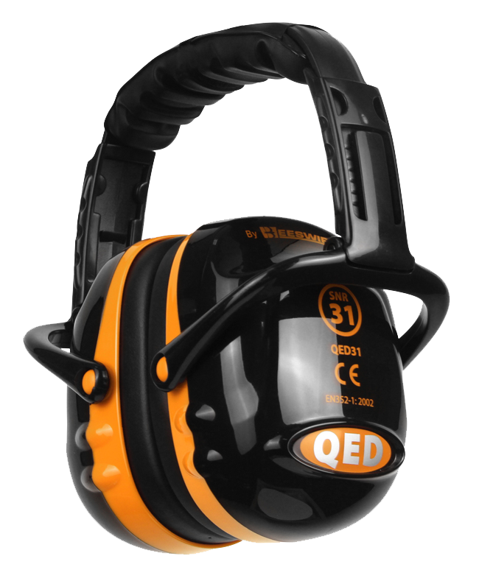
What are the main changes?
• Moving hearing protection from Category II to Category III PPE.
• Moving life jackets from Category II to Category III PPE.
• Issuing a Declaration of Conformity with each PPE or at least a link to where it can be obtained.
• A compulsory maximum five-year certificate validity.
• Responsibilities outlined for importers and distributors.
• Bespoke PPE covered in the Regulation.

Slide 4
Other smaller changes include:
• CAT I (Minimal risk) items are now covered under Module A for self certification.
• CAT II (Intermediate) items are now covered under Module B and will be issued an EU type certificate from notified bodies.
• CAT III (Complex) items are now covered under:
• Module C2 (used to be Article 11A) which is ongoing surveillance through testing.
• Module D (used to be Article 11B) which is ongoing surveillance through factory auditing.

Slide 5
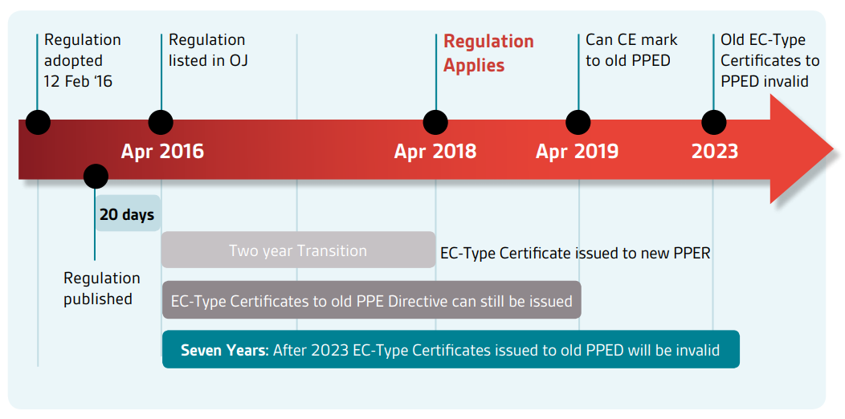
Timescale:

Slide 6

Timescale Breakdown:
• Once a test house is accredited to the EU regulation they are able to test and issue post dated certificates which will come into effect April 2018.
• Manufacturers are able to “make available on the market” under the old directive until April 2019. This means that until April 2019 product can be manufactured but after April 2019 ALL product made must be to the new regulation.
• All of the old EC type certification shall expire April 2023 unless an earlier expiry date exists.
• All technical information MUST be available for 10 years, even if the item is discontinued.
• The manufacturer shall submit his application at the earliest 12 months and at the latest 6 months prior to the expiry date of the EU Type-Examination certificate.

Slide 7
What does this mean to Beeswift?
All these changes won’t effect Beeswift too much as we have been leading the way and doing a lot of the changes that have been made for many years.
• Moving hearing protection from Category II to Category III PPE. (Will be done before expiry deadline 21/04/2019)
• Moving life jackets from Category II to Category III PPE. (Does not apply to Beeswift)
• Issuing a Declaration of Conformity with each PPE or at least a link to where it can be obtained. (All Declarations, User sheets and care labels have been available online for years. All User sheets have been re-designed in advance to include a link to them)
• A compulsory maximum five-year certificate validity. (Been doing this for many years)
• Responsibilities outlined for importers and distributors. (Already give our customers access to sizing, Declarations, User sheets & Care Labels. Certificates will be available on Beeswift online as of 21/04/2018)
• Bespoke PPE covered in the Regulation. (Does not apply to Beeswift)

Slide 8
What does this mean to the supply chain?
Our customers will need to:
• When making PPE available on the market, all involved shall act with due care in relation to the requirements of this Regulation.
• Before making PPE available on the market, distributors shall verify that it bears the CE marking, is accompanied by the required instructions in a language which can be understood by end-users in the country which PPE is to be made available.
• Distributors shall ensure that, while the PPE is under their responsibility, storage or transport conditions do not jeopardise its conformity.
• Distributors who consider or have reason to believe that PPE which they have made available on the market is not in conformity with this Regulation shall withdraw it or to recall it.

Slide 9
This presentation’s intellectual property and design where applicable belongs to:
BEESWIFT Ltd, Delta Point, Greets Green Road, West Bromwich, B70 9PL. UK.
For further information please visit www.Beeswift.co.uk
Or contact a sales representative at sales@Beeswift.com

